Slide 1


VS.
Tracking COVID-19 Cases in San Francisco and Los Angeles Counties based on Mobility Data
Notes:
# Presentation GuidelinesYou are free to structure your presentations to your liking, but students tend to have success with the following format.* Title Slide * Include the name of the Project and Group Members* Motivation & Summary Slide * Define the core message or hypothesis of your project. * Describe the questions you asked, and _why_ you asked them * Describe whether you were able to answer these questions to your satisfaction, and briefly summarize your findings* Questions & Data * Elaborate on the questions you asked, describing what kinds of data you needed to answer them, and where you found it* Data Cleanup & Exploration * Describe the exploration and cleanup process * Discuss insights you had while exploring the data that you didn't anticipate * Discuss any problems that arose after exploring the data, and how you resolved them * Present and discuss interesting figures developed during exploration, ideally with the help of Jupyter Notebook* Data Analysis * Discuss the steps you took to analyze the data and answer each question you asked in your proposal * Present and discuss interesting figures developed during analysis, ideally with the help of Jupyter Notebook* Discussion * Discuss your findings. Did you find what you expected to find? If not, why not? What inferences or general conclusions can you draw from your analysis?* Post Mortem * Discuss any difficulties that arose, and how you dealt with them * Discuss any additional questions that came up, but which you didn't have time to answer: What would you research next, if you had two more weeks?* Questions * Open-floor Q&A with the audience

Slide 2
Group Members
Amy Chang
Shahrzad Khoobyari
Stuart Hunter
Michelle Taymuree
Victor Tran

Slide 3

COVID-19 Cases in LA & SF County
LA county and SF county are the two main urban centers in the state of California
LA county drastically different COVID-19 trajectory in comparison to San Francisco county
Same state and same governing policies, yet significant differences in COVID-19:
Testing
Cases
Hospitalizations
Deaths
Notes:
define the core message or hypothesis of your project. * Describe the questions you asked, and _why_ you asked them * Describe whether you were able to answer these questions to your satisfaction, and briefly summarize your findings
Key driving question was why the difference in LA and SF. They are dramatic and well publicized within the state and no apparent answers are available. Thus, we wanted to look at COVID in these two main urban hubs of California

Slide 4

COVID-19 Cases in LA County and SF County
Why the discrepancy?
Areas to focus on:
Socioeconomics
Demographics
If we look at mobility data of the two counties, will we see a differences?
Which urban center:
Stayed home more
Changed retail shopping behavior
Utilized public transportation more or less
Shifted to work from home
Did these behavior changes correlate to a spike in COVID-19 cases?
Is there a connection between COVID-19 community spread and mobility?
Notes:
Data examined: Covid 19 data from public health agencies to measure testing, cases, hospitalizations, ICU beds and death rates between the two counties. We also looked at population data and key demographic data to see how socioeconomics could influence mobility and work from home abilities
Narrowing the scope was essential, thus we focused in on APPLE based mobility data. Of course this then limited us to Apple users only. For the scope of this project we felt comfortable with this data limitation

Slide 5

Data Query Insights
Initial proposal to compare county policies
Goal to compare policies from different regions and track COVID-19 cases
Insufficient data from HHS for SF, LA and other metropolitan centers around the country
Singular data points from various regions provided little to no insights
Data from Apple used instead
Mobility data used as a proxy for behavior
Covid-19 testing used as a proxy for intervention
Limited to Apple users only however
Notes:
Describe the exploration and cleanup process * Discuss insights you had while exploring the data that you didn't anticipate * Discuss any problems that arose after exploring the data, and how you resolved them * Present and discuss interesting figures developed during exploration, ideally with the help of Jupyter Notebook
Graphs were very busy and needed to be segmented based on our story
Lots of information to parse out, we end up having more data than we could reasonably use

Slide 6
COVID-19: SF and LA

Slide 7
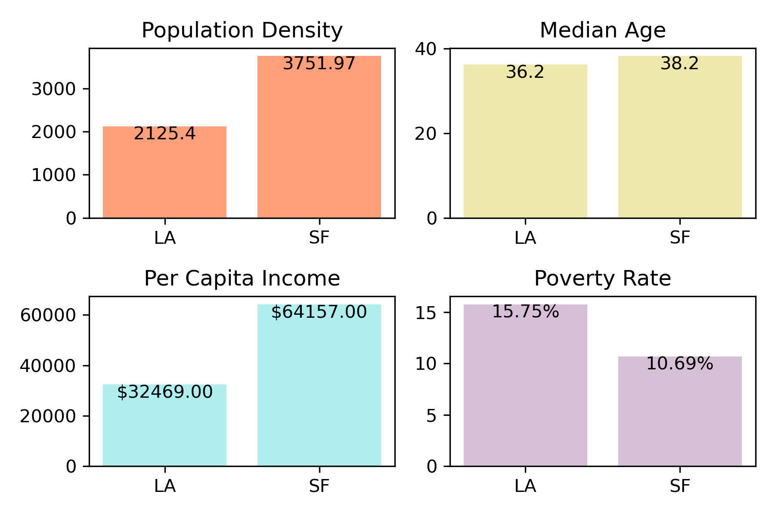
County Demographic Data
SF County more densely populated than LA County
SF County’s median income is double that of LA County
Poverty rate in LA County is 33% higher than that of SF County
Health care disparities in LA County’s poorest communities
Median age is nearly the same
Elderly population at greater risk of COVID-19 complications not a confounding factor in our data set

Slide 8
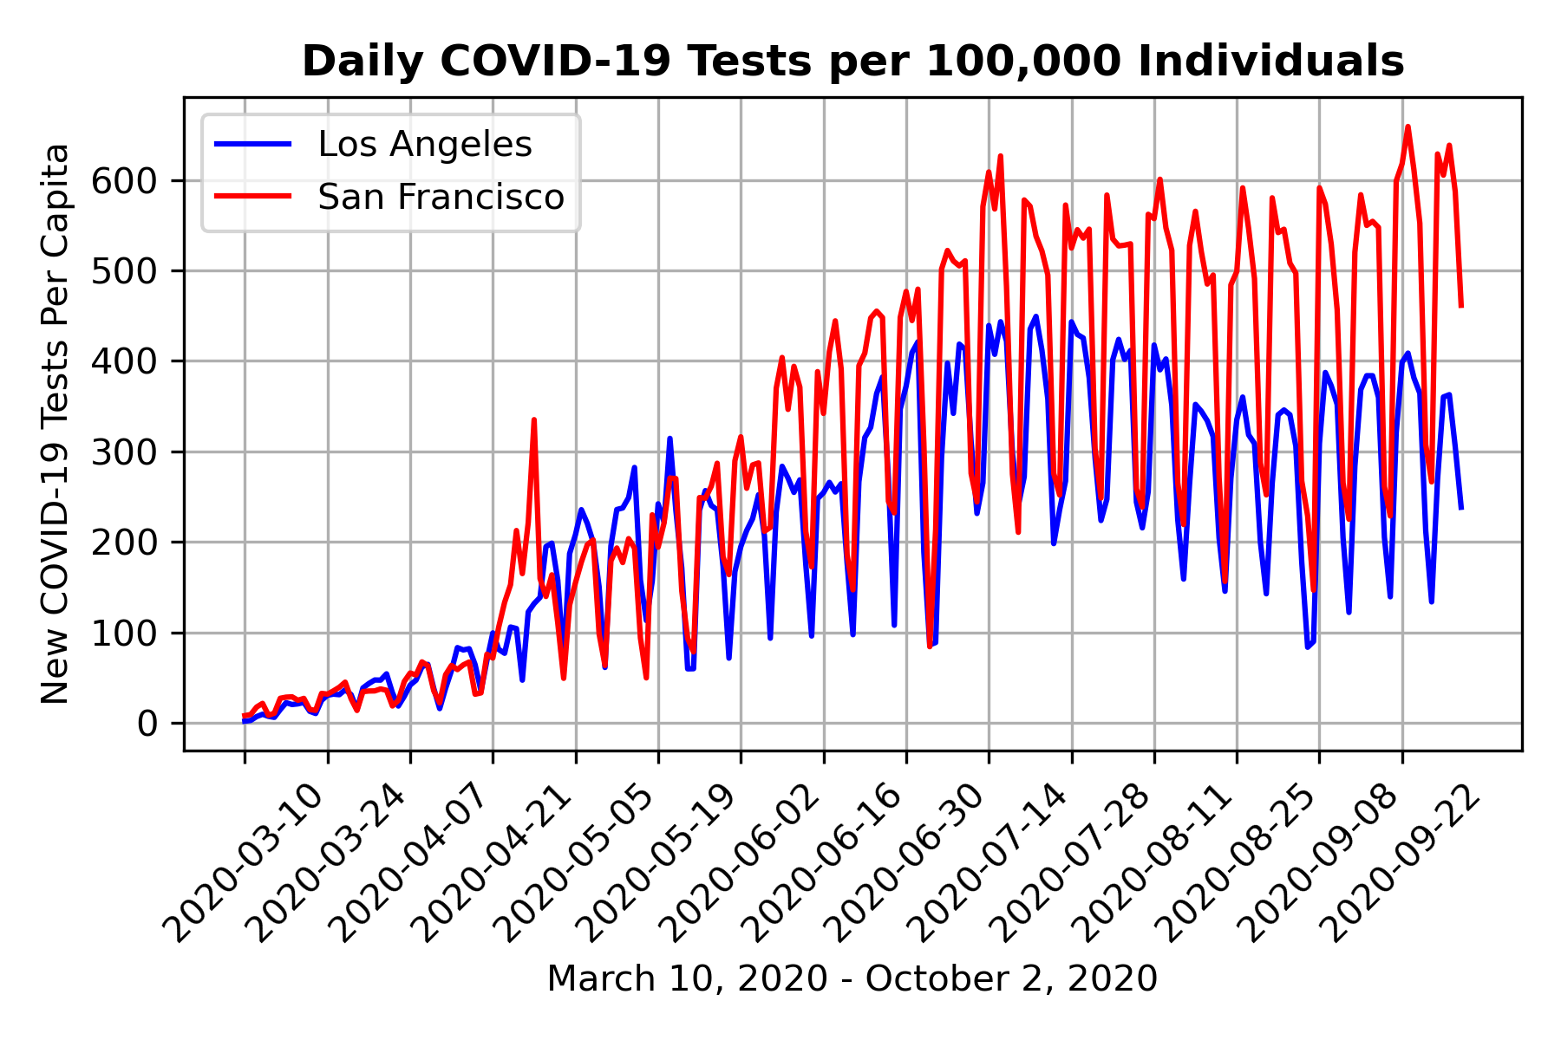
Testing Rates: SF vs LA County
Notes:
Testing rates per capita were relatively equal in the early months, clear separation by beginning of July. SF county residents were tested more in comparison to LA county. Testing is key in reducing community spread.

Slide 9
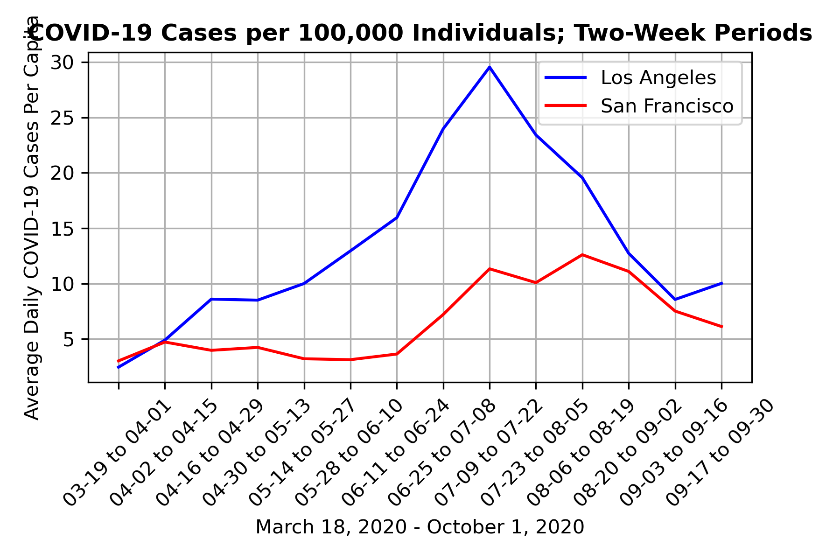
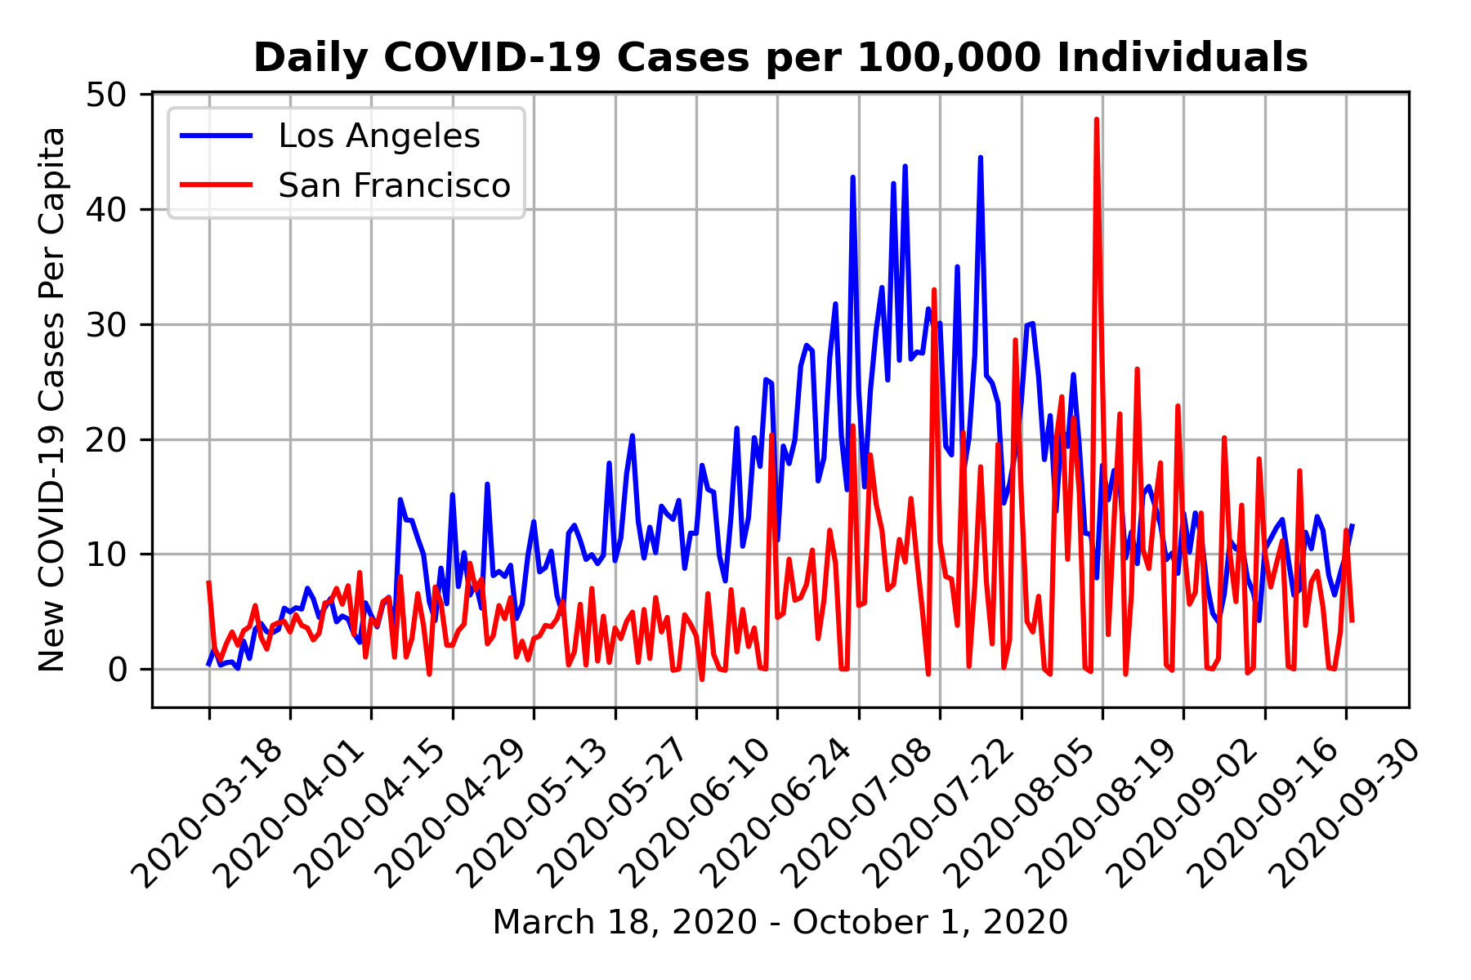
Daily Cases: SF vs LA County
Notes:
Spike in positive cases in August, could be state wide backlog??
Even with reduced testing, LA county had a considerable peak towards the end of July.
Cases between the counties are normalizing and have been steadily declining

Slide 10
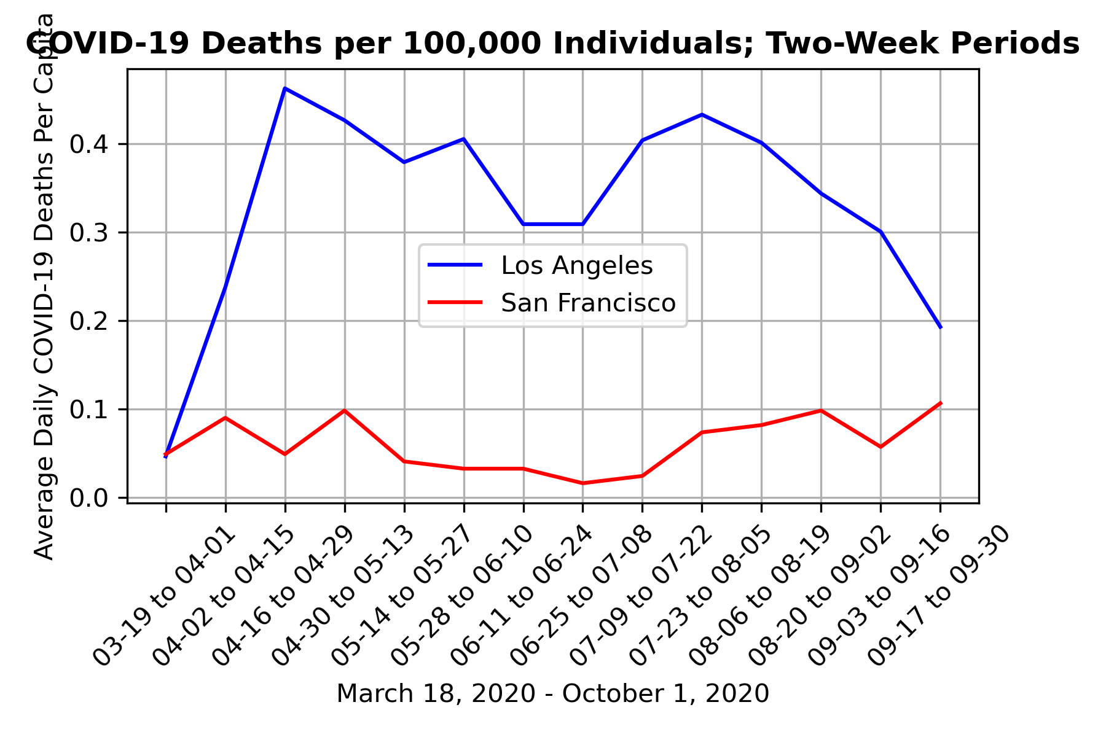
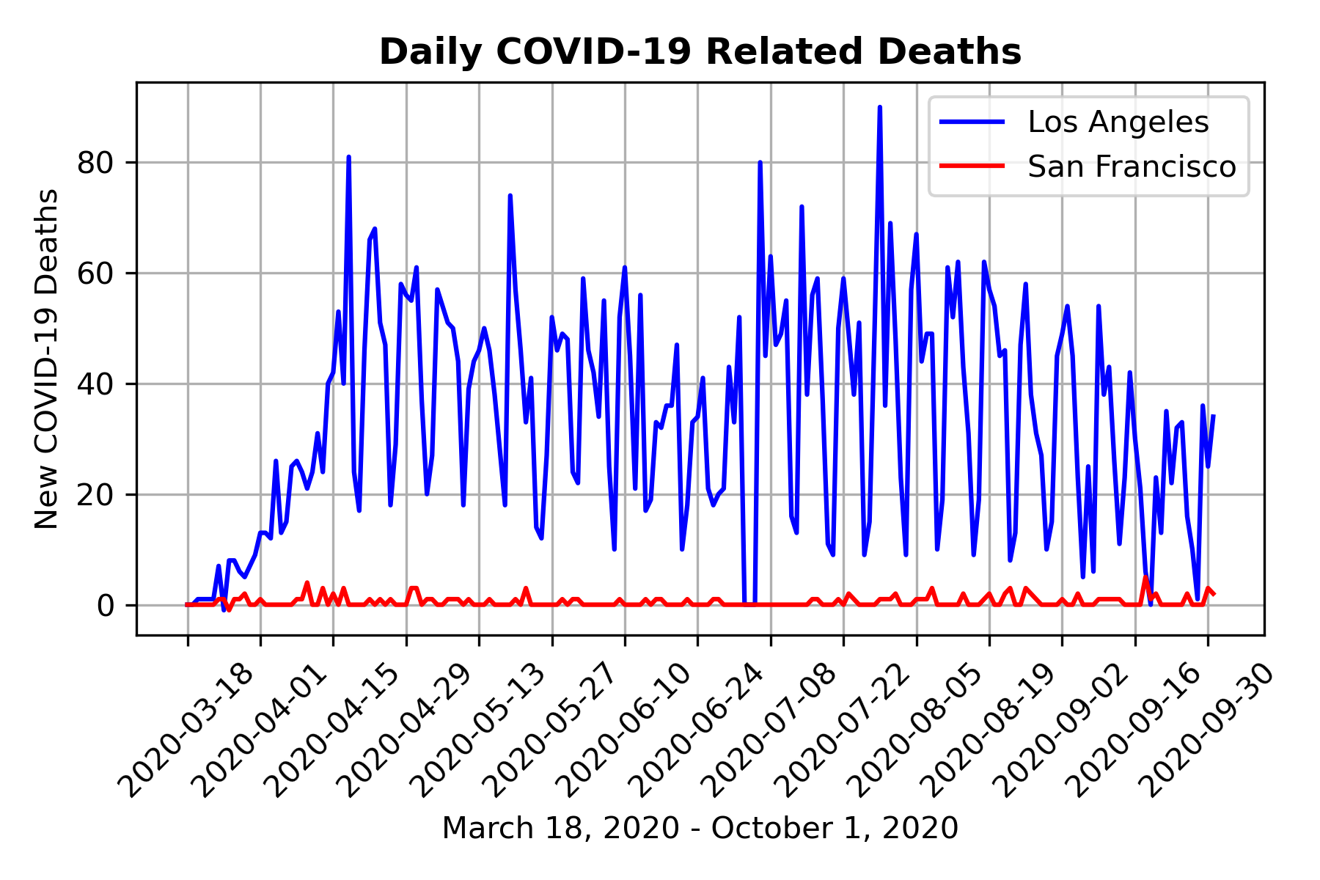
COVID-19 Related Deaths
Notes:
Dramatic differences in death rates between the counties. Back to original question, can we see difference in mobility trends to explain?
These graphs again paint the picture of the dramatic differences in COVID-19 trajectories btwn the two counties. LA’s death rate remains significantly higher than SF

Slide 11

Mobility Data Analysis

Slide 12
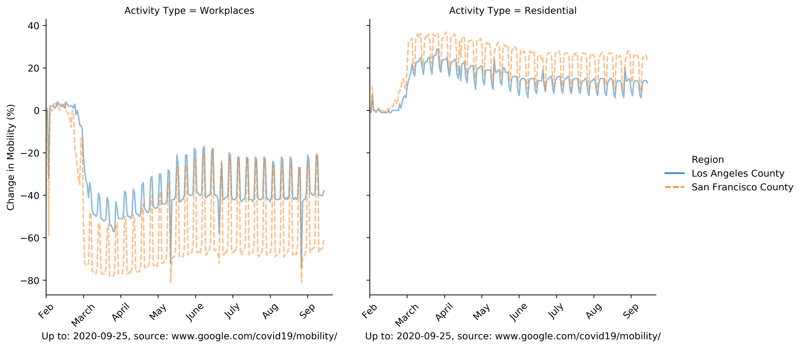
Workplace & Residential Mobility
Notes:
data limitations; Apple users only
Tracked by cell phone measurements
Looking at these graphs, SF residents increase in mobility around their homes has increased more so than in LA county
Conversely, SF county residents also saw a greater decrease in mobility at their workplace, indicating SF county residents may have more WFH options and less need to be in a work place environment setting
The percent increase in home mobility and decreased in workplace mobility is greater in SF county
Next we look at the industries to see if there are any clues as to why workers in SF county may have more potential for WFH versus LA
Discuss the steps you took to analyze the data and answer each question you asked in your proposal * Present and discuss interesting figures developed during analysis, ideally with the help of Jupyter Notebook

Slide 13
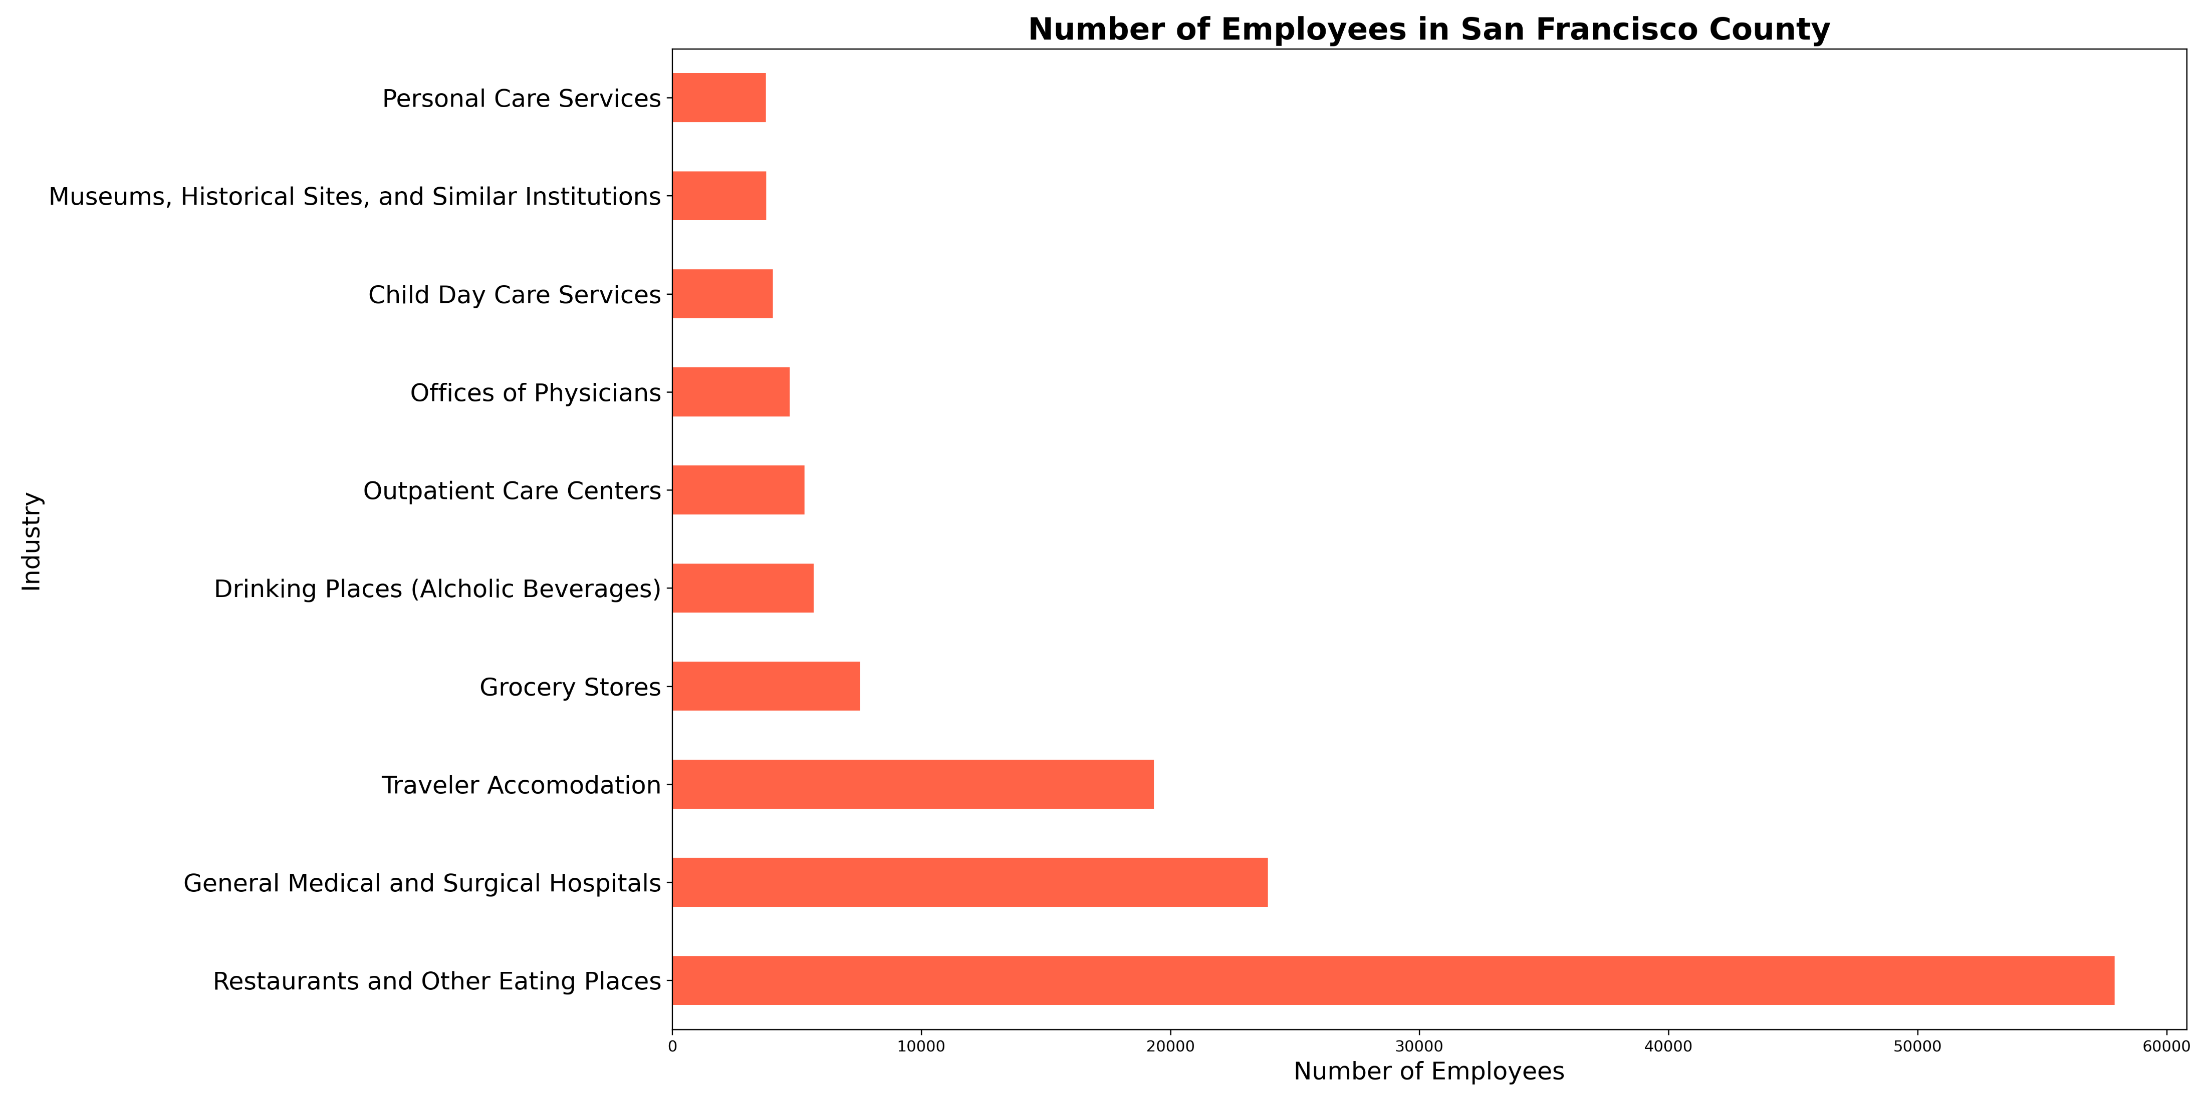
SF County Top 10 Areas of Employment
Top 10 Industries in SF County:
Restaurants
Health Care: Systems
Travel Industry
Grocery Stores
Bars and Pubs
Health Care: Outpatient (Ambulatory) Care
Health Care: Physician Offices
Child Care Services
Museum and Historical Sites
Personal Care Services
Notes:
Looking at top 10 employment industries, could see a correlation in what jobs could offer work from home advantages between the two areas?

Slide 14
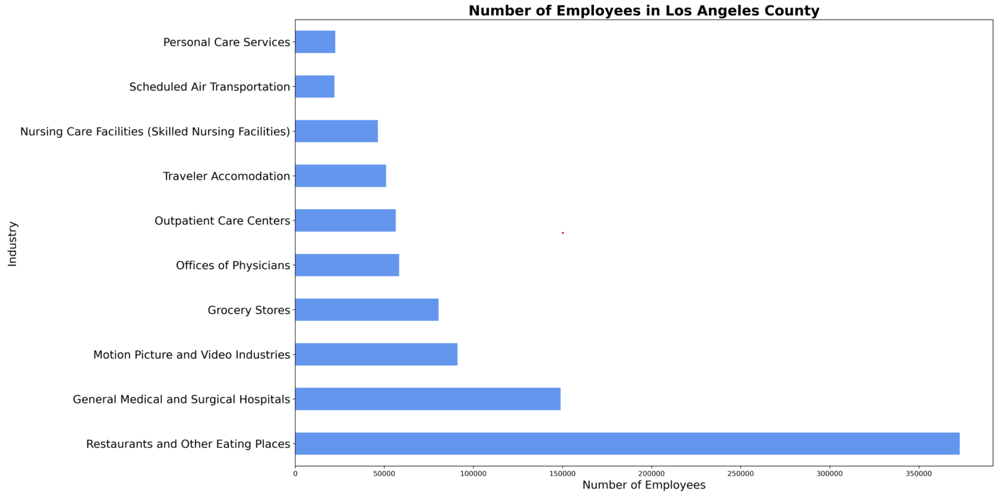
LA County Top 10 Areas of Employment
Top 10 Industries in LA County:
Restaurants
Health Care: Systems
Film Industry
Grocery Stores
Health Care: Physician Offices
Health Care: Outpatient (Ambulatory) Care
Travel Industry
Health Care: Skilled Nursing
Air Travel
Personal Care Services
Notes:
No surprisingly. Film industry a top employer for LA county.

Slide 15
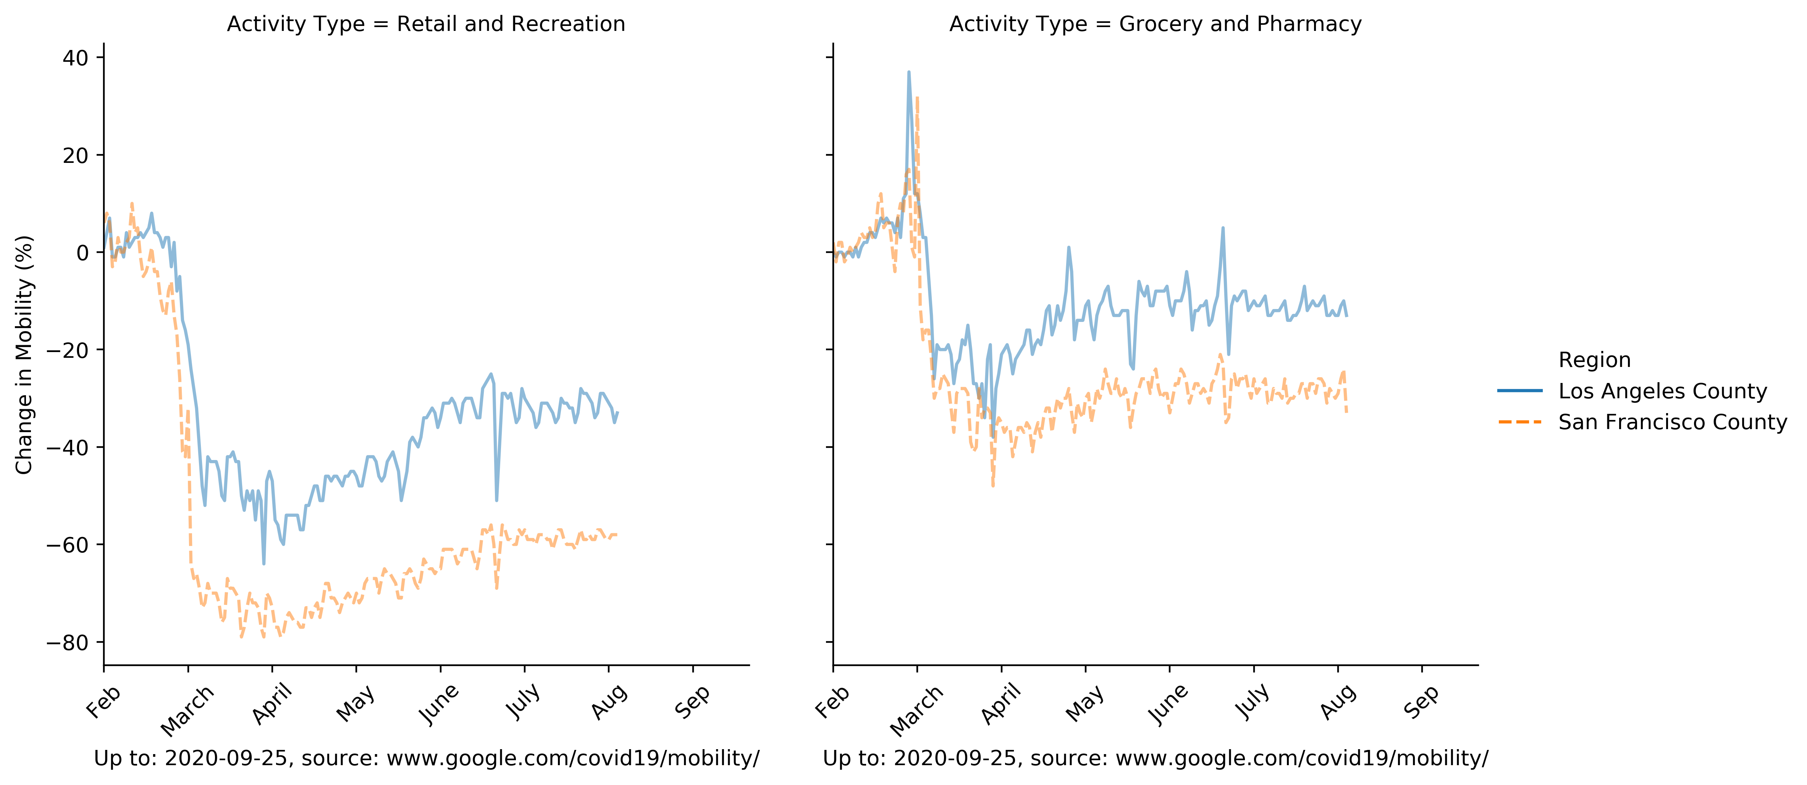
Retail and Grocery Mobility
Notes:
Dramatic decreases in mobility in SF county. Retail and recreation has decreased especially in relation to LA county

Slide 16
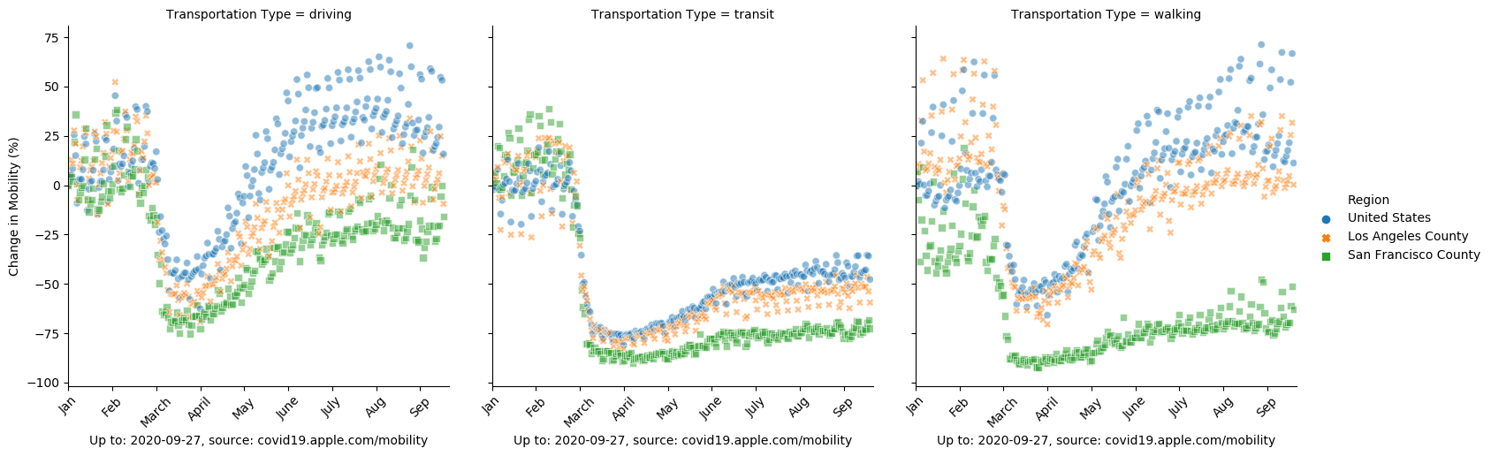
Transportation Data: USA, LA and SF
Notes:
Jan and Feb is pre-Covid in the US.
Important call outs include the high use of public transportation in SF county, the relatively even mix of driving and LA’s higher than national and SF county for walking, as this includes exercise and not limited to walking to work etc
Compared to the US, SF county has dramatic changes in its mobility. Transit use has decreased by 85-90%, as demonstrated by pictures of deserted streets of SF, this data corroborates those images, as citizens have decreased their walking as a form of transportation or exercise as compared to pre-Covid. However, comparing SF and LA’s data to the nation, the perception that California is taking covid more seriously with stricter regulations and laws, this image helps tell this story as well.

Slide 17
Discussion
SF County vs LA County
More testing in SF County
Fewer cases in SF County
Fewer deaths in SF County
Shelter in Place
Bay Area, including SF County, was first in state and nation to “lockdown”
SF County mobility changes have persisted
Transit use in SF County remains very low in comparison to pre-COVID timeframe
Retail shopping in SF county remains significantly lower than LA County
LA County’s mobility changes did not dip as low as SF
Mobility data on walking has returned to pre-COVID numbers for LA
Industries of employment
Conclusions and correlations on workplace changes hard to extrapolate from this data
Notes:
Discuss your findings. Did you find what you expected to find? If not, why not? What inferences or general conclusions can you draw from your analysis?

Slide 18
Challenges
Access issues with certain data sets
USC data provided excellent data resources for LA county only
Health insurance and hospital data is complex
Hard to aggregate and draw conclusions
Privacy and HIPPA concerns
California open source data website
APIs limited queries to 100 elements out of 18k
Reading the csv file from the open source data was far more efficient
After data analysis was complete, discovered the Office of Management & Budget classifies
SF Bay Area as SF county plus 4 other counties
LA and Orange County
Each metropolitan area is defined as having at least one urban core area with a high population plus adjacent territories that are highly integrated
Looking at SF county only is a small sample size and does not truly account for trends in the greater metropolitan area
Notes:
* Discuss any difficulties that arose, and how you dealt with them * Discuss any additional questions that came up, but which you didn't have time to answer: What would you research next, if you had two more weeks?

Slide 19
Questions?
Notes:
# Presentation GuidelinesYou are free to structure your presentations to your liking, but students tend to have success with the following format.* Title Slide * Include the name of the Project and Group Members* Motivation & Summary Slide * Define the core message or hypothesis of your project. * Describe the questions you asked, and _why_ you asked them * Describe whether you were able to answer these questions to your satisfaction, and briefly summarize your findings* Questions & Data * Elaborate on the questions you asked, describing what kinds of data you needed to answer them, and where you found it* Data Cleanup & Exploration * Describe the exploration and cleanup process * Discuss insights you had while exploring the data that you didn't anticipate * Discuss any problems that arose after exploring the data, and how you resolved them * Present and discuss interesting figures developed during exploration, ideally with the help of Jupyter Notebook* Data Analysis * Discuss the steps you took to analyze the data and answer each question you asked in your proposal * Present and discuss interesting figures developed during analysis, ideally with the help of Jupyter Notebook* Discussion * Discuss your findings. Did you find what you expected to find? If not, why not? What inferences or general conclusions can you draw from your analysis?* Post Mortem * Discuss any difficulties that arose, and how you dealt with them * Discuss any additional questions that came up, but which you didn't have time to answer: What would you research next, if you had two more weeks?* Questions * Open-floor Q&A with the audience

Slide 20
Appendix

Slide 21
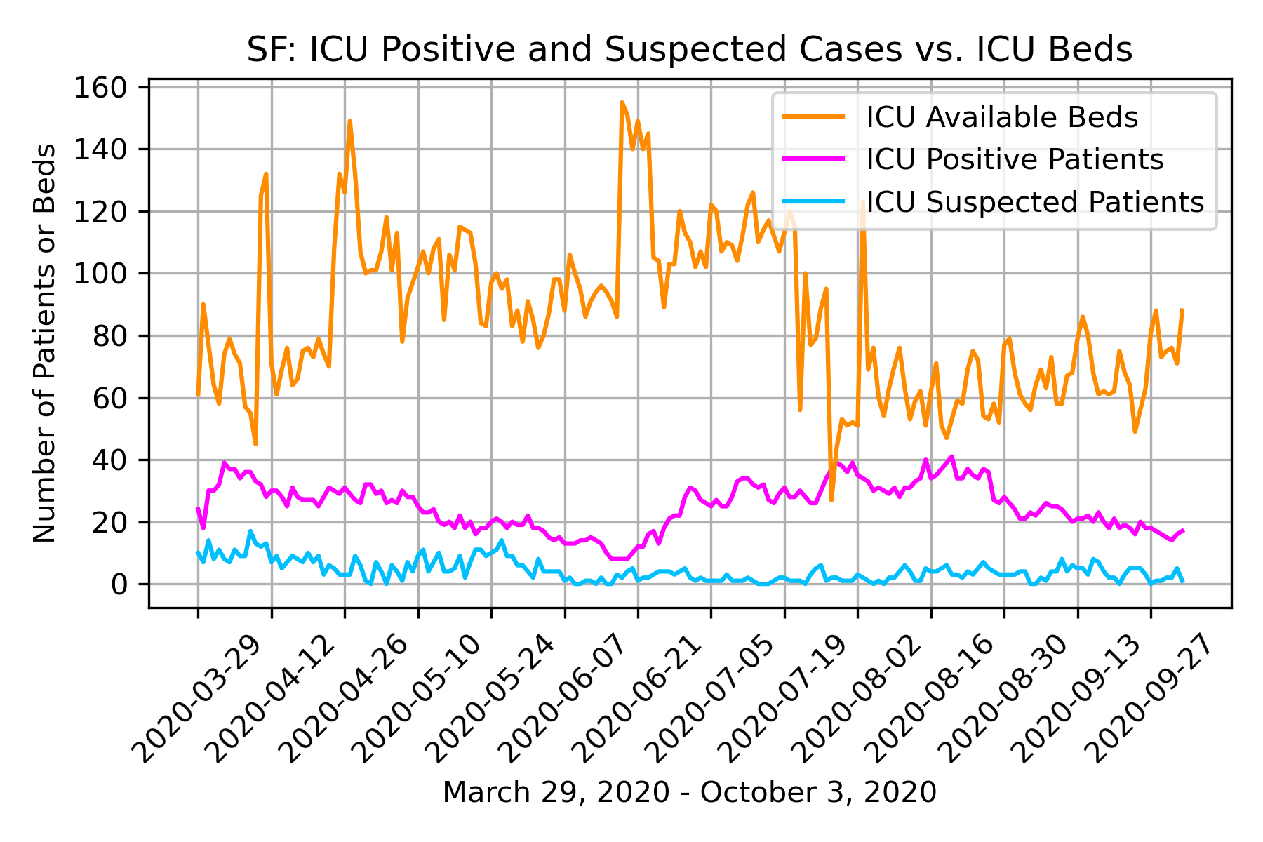
ICU Hospital Bed Capacity: SF

Slide 22
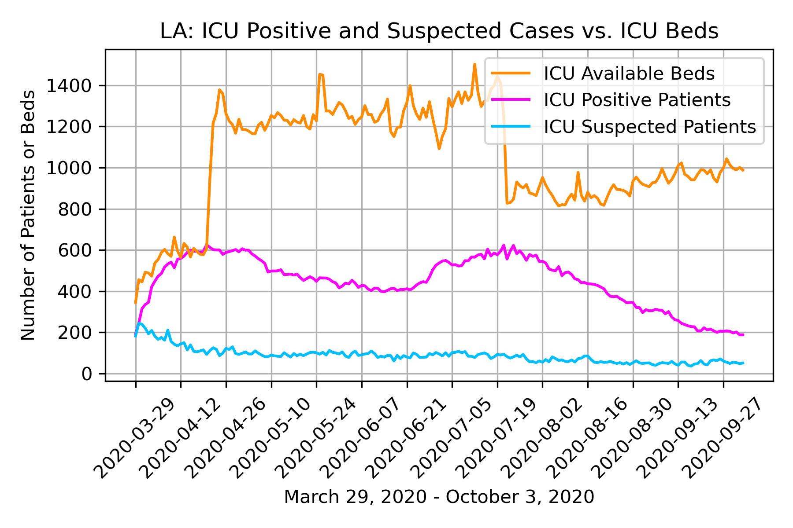
ICU Hospital Bed Capacity: LA

Slide 23
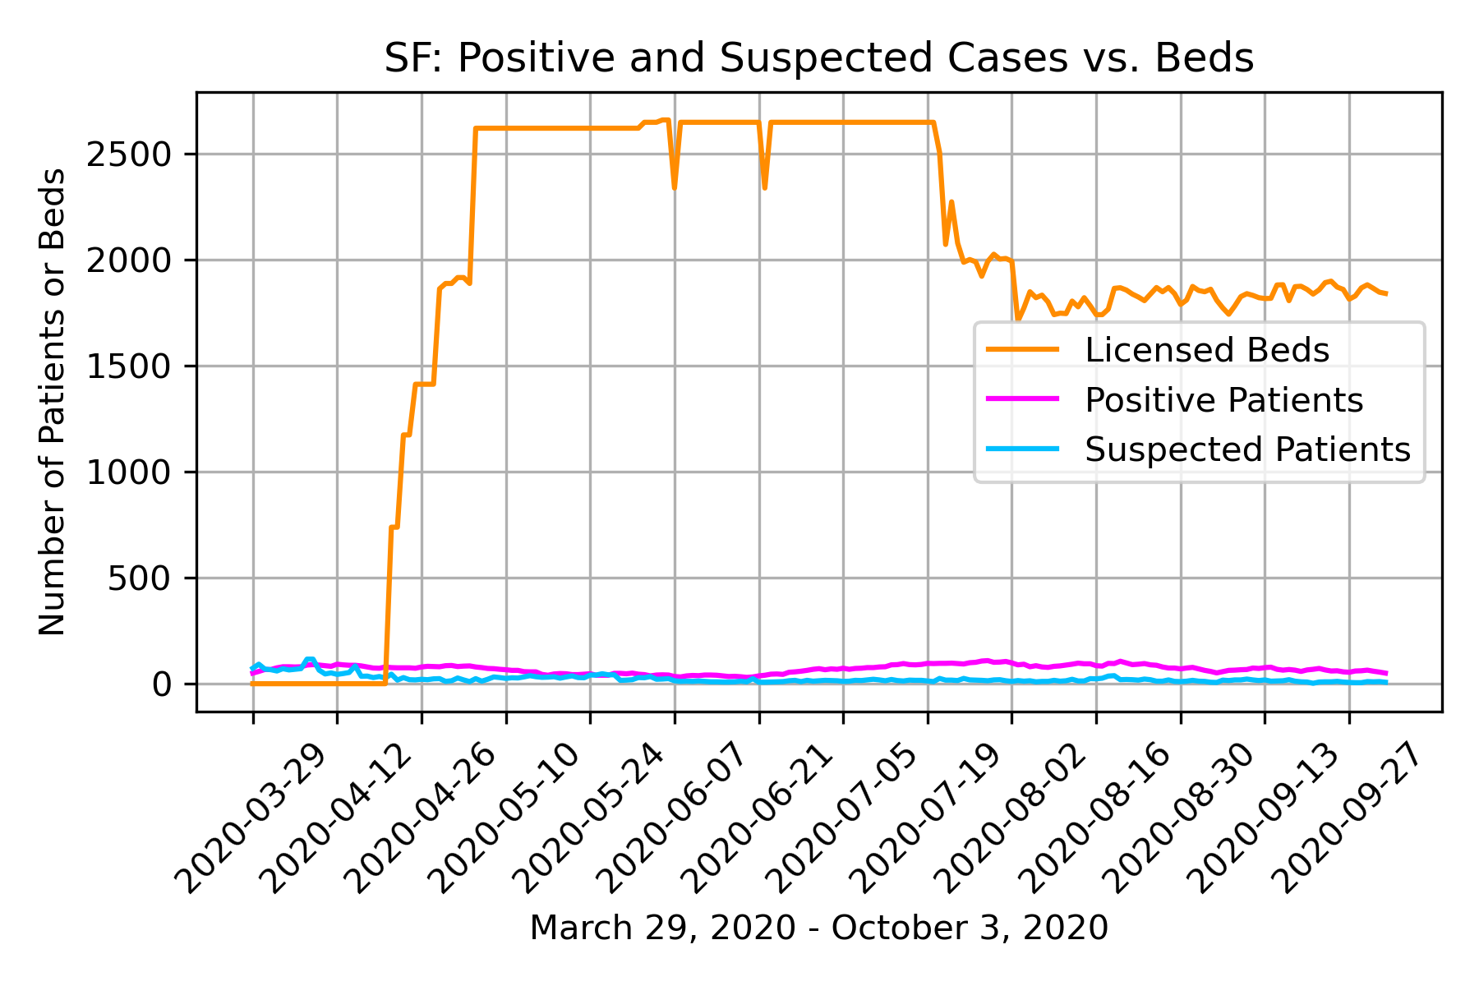
Hospital Bed Capacity: SF

Slide 24
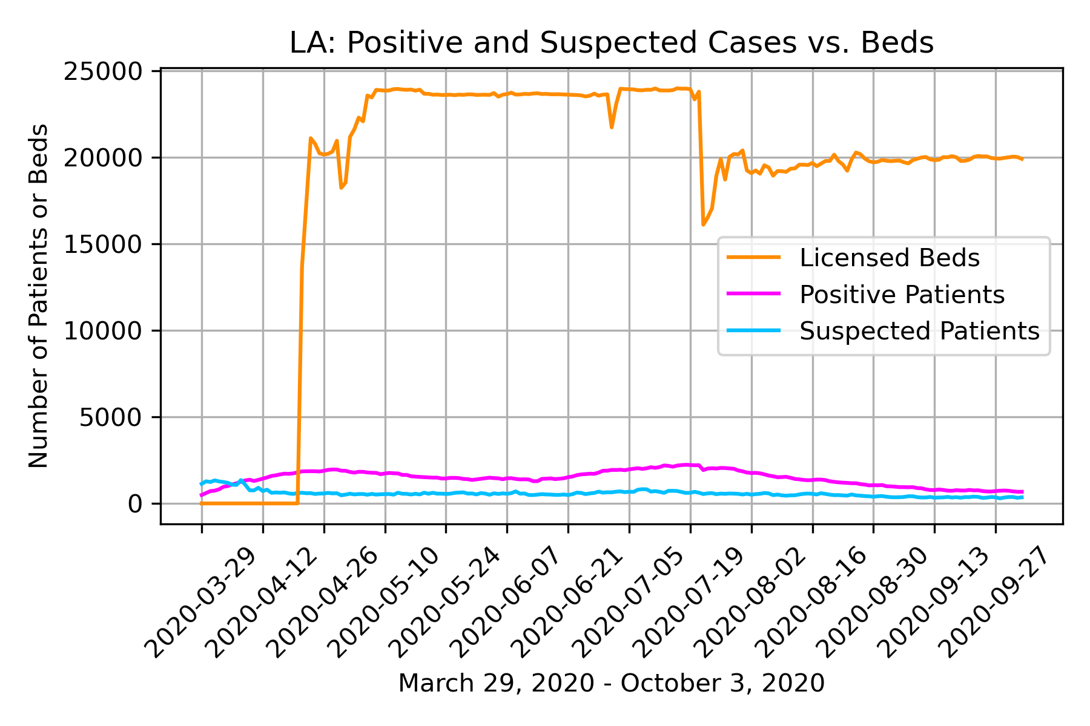
Hospital Bed Capacity: LA

Slide 25
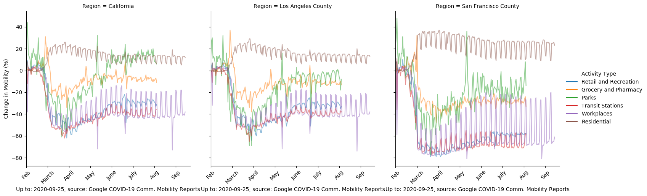
Overall Mobility Data

Slide 26
Citations
https://www.google.com/covid19/mobility/
https://covid19.apple.com/mobility
https://api.census.gov/data/2018/cbp
https://api.census.gov/data/2018/acs/acs5
https://data.sfgov.org/COVID-19/Covid-19-Tests/nfpa-mg4g
http://dashboard.publichealth.lacounty.gov/covid19_surveillance_dashboard/
https://data.ca.gov/dataset/covid-19-cases/resource/926fd08f-cc91-4828-af38-bd45de97f8c3
http://healthdata.gov/

